Slide 1
CUSR Ticket RESERVATION SYSTEM

Slide 2
introduction
The aim of the project was to deal with the challenges of managing the information of tickets, trains, customers, fares and notifications.
The system is designed for the reservation and cancellation of tickets for the passengers.
It reduces the manual work involved in management and provides an end to end solution to the railway reservation system.

Slide 3
High level design
Technologies Used:
Spring Boot
Angular JS
JPA/Hibernate
MySql
Maven
Spring boot starter freemarker
MVC

Slide 5
Major features
User Features
User registration and login
Train search mechanism
Purchase tickets
Ticket cancellation
Email notification
Facebook and Google sign in support
Seats availability check
Admin Features
Train Cancellation
Reset Train capacity

Slide 6
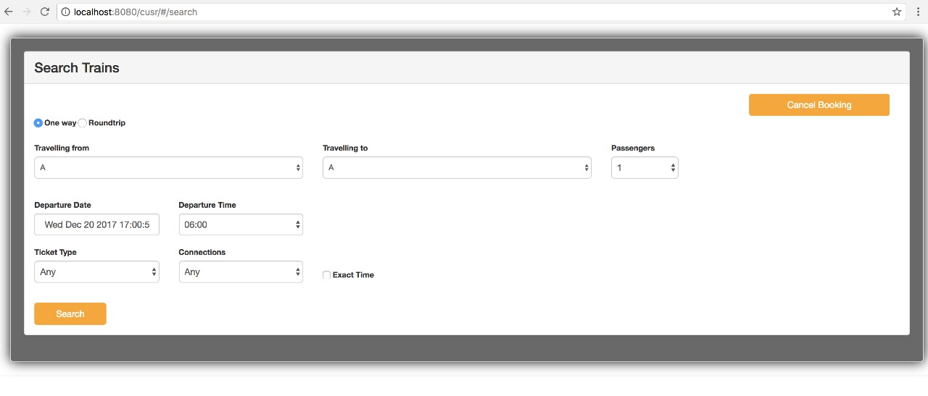
screenshots
Train search one way trip

Slide 7
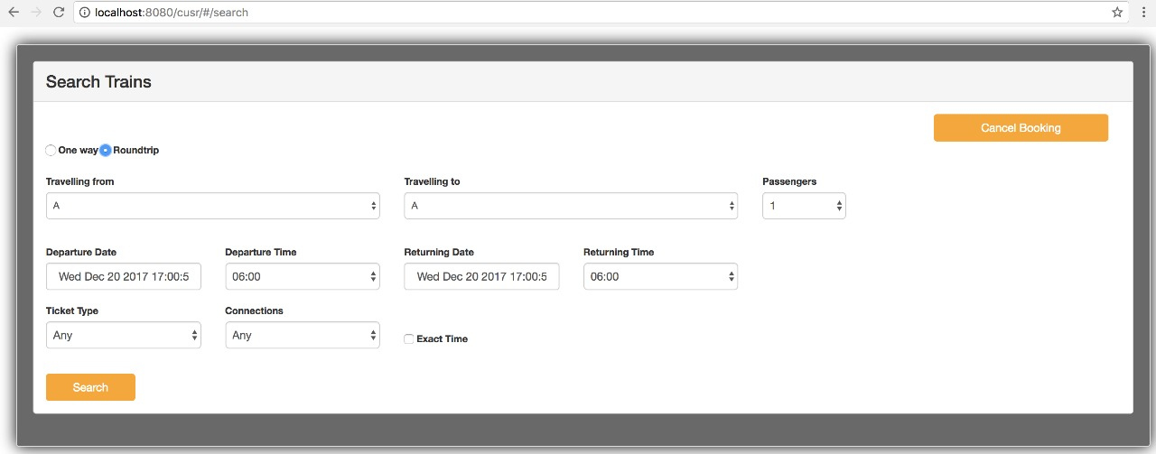
Train search return trip

Slide 8
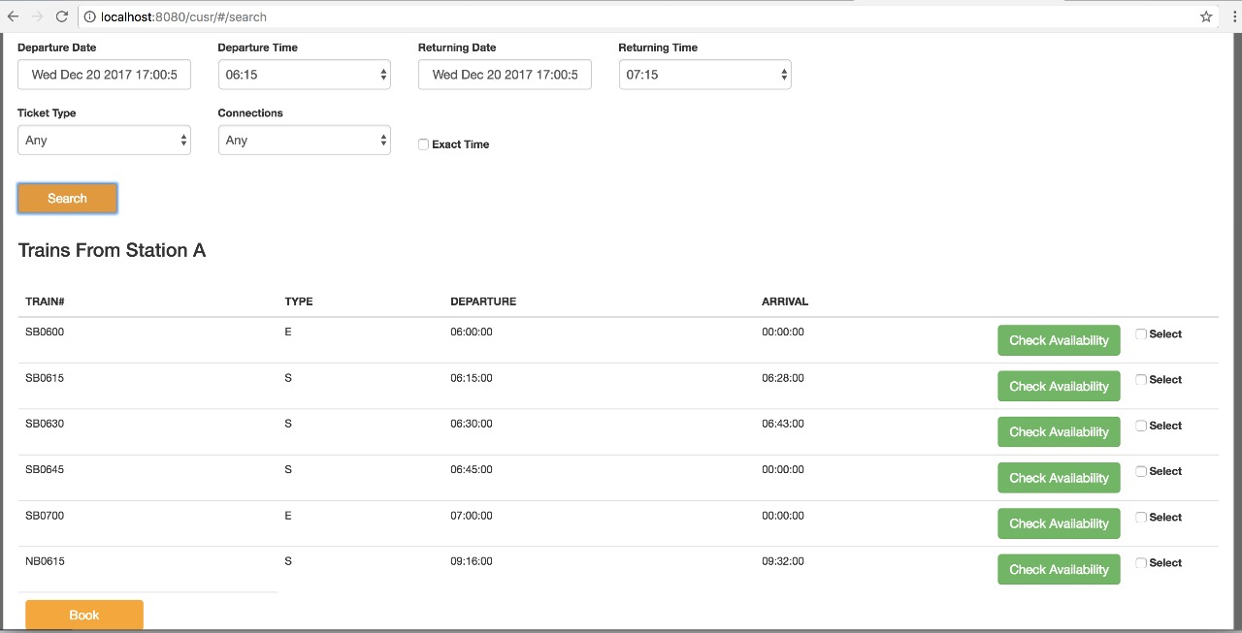
Search results

Slide 9
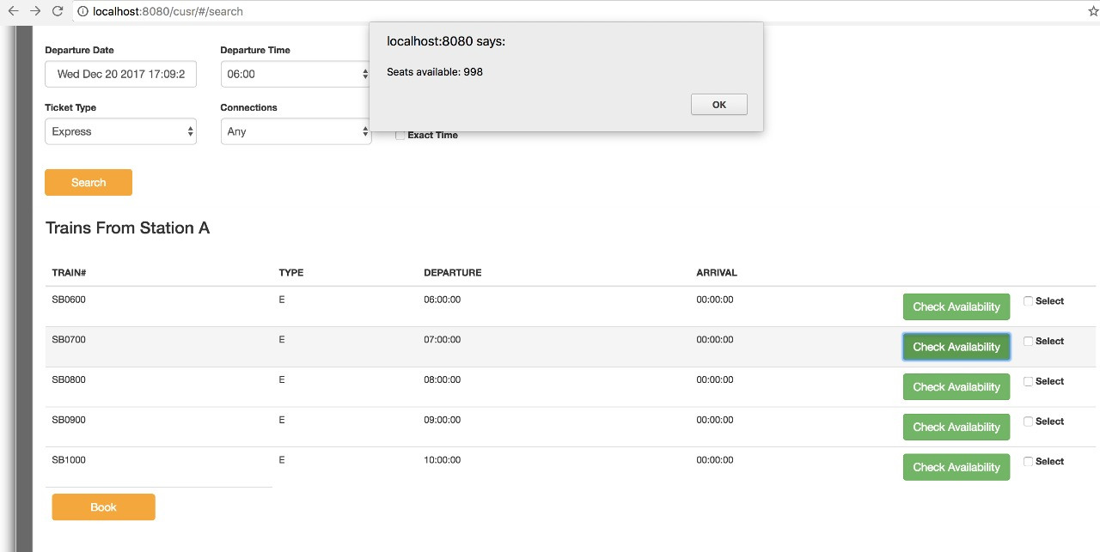
Seats availability check

Slide 10
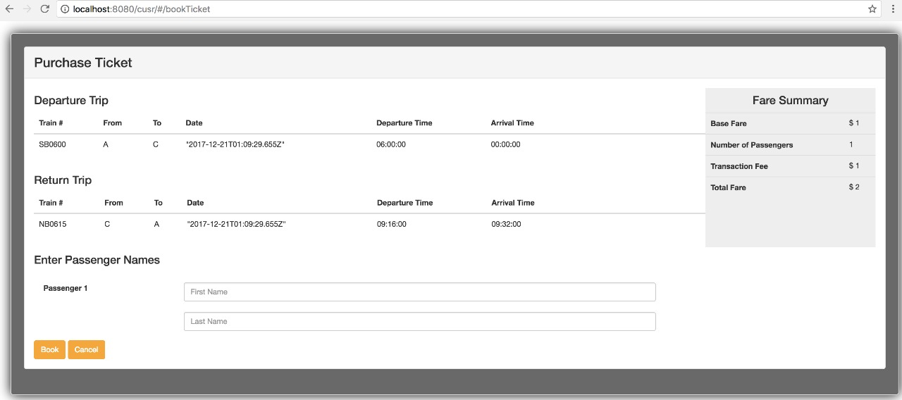
Purchase Ticket

Slide 11
Admin module

